Slide 1

My Linear Relationships Interactive Notebook
Name
Class
Term 3 Semester 2

Slide 2
Contents
Formula Page
Page
Date
Description
2
3

Slide 3
Tasks
24
7
30
Essential Question
Questions
Notes
Summary
8
9

Slide 4
24
7
30
Date
Drawing Linear Graphs
EQ – How do you draw a graph given the equation?
11

Slide 5
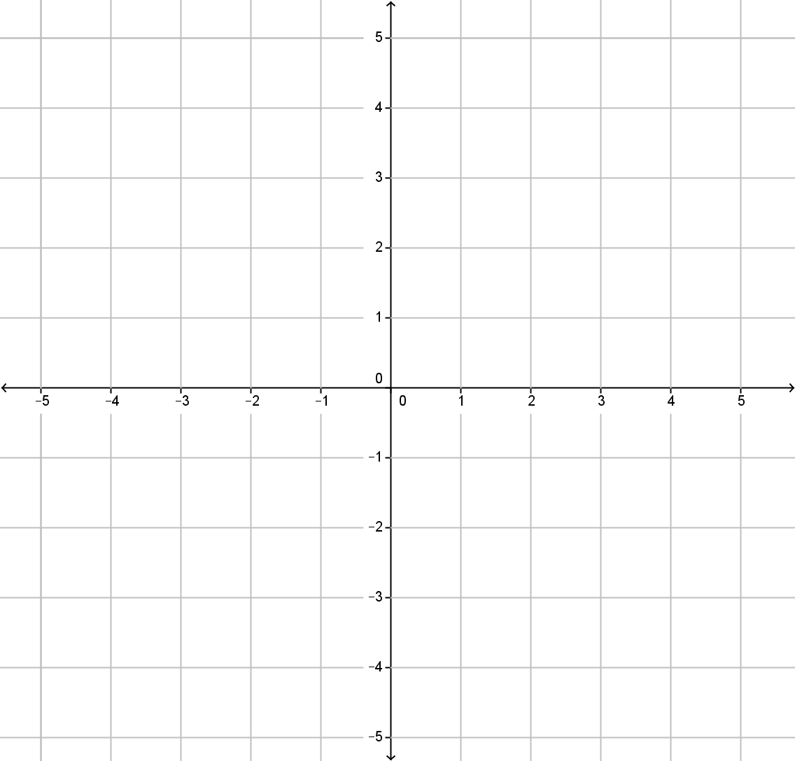


Draw a coordinate grid from -5 to 5 on both axes.
$$y$$
$$x$$

Slide 6
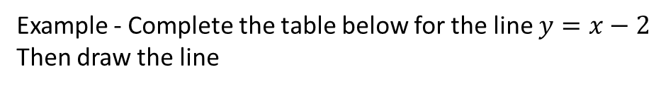
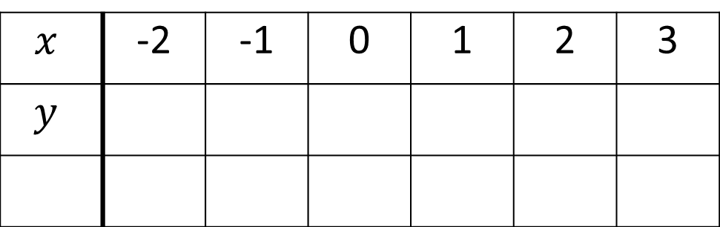
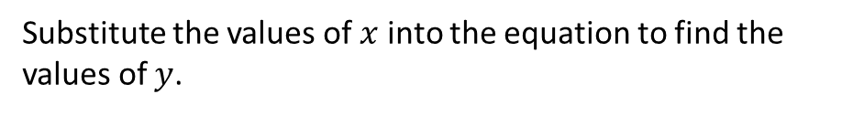
24
7
30
Date
Drawing Linear Graphs
EQ – How do you draw a graph given the equation?
Substitute the values of $x$ into the equation to find the values of $y$.
Example - Complete the table below for the line $y=x−2$
Then draw the line
$$x$$ | -2 | -1 | 0 | 1 | 2 | 3
$$y$$
9

Slide 7
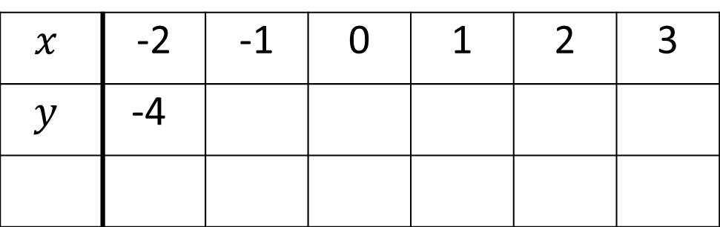
24
7
30
Date
Drawing Linear Graphs
EQ – How do you draw a graph given the equation?
Substitute the values of $x$ into the equation to find the values of $y$.
Example - Complete the table below for the line $y=x−2$
Then draw the line
$$x$$ | -2 | -1 | 0 | 1 | 2 | 3
$$y$$ | -4
9

Slide 8
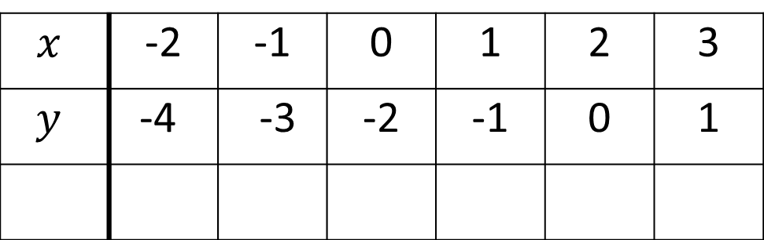
24
7
30
Date
Drawing Linear Graphs
EQ – How do you draw a graph given the equation?
Substitute the values of $x$ into the equation to find the values of $y$.
Example - Complete the table below for the line $y=x−2$
Then draw the line
$$x$$ | -2 | -1 | 0 | 1 | 2 | 3
$$y$$ | -4 | -3 | -2 | -1 | 0 | 1
9

Slide 9
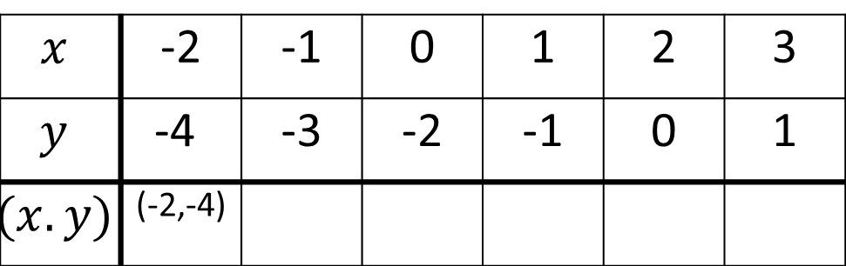
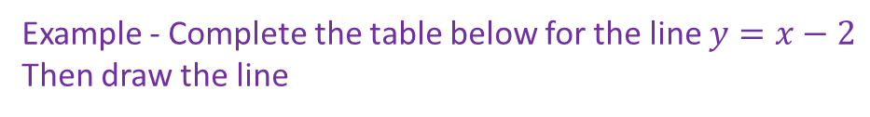
24
7
30
Date
Drawing Linear Graphs
EQ – How do you draw a graph given the equation?
Substitute the values of $x$ into the equation to find the values of $y$.
Example - Complete the table below for the line $y=x−2$
Then draw the line
$$x$$ | -2 | -1 | 0 | 1 | 2 | 3
$$y$$ | -4 | -3 | -2 | -1 | 0 | 1
$$(x.y)$$ | (-2,-4)
Plot these coordinates on a number plane
9

Slide 10
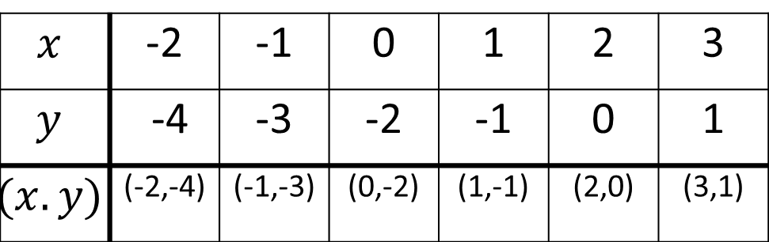
24
7
30
Date
Drawing Linear Graphs
EQ – How do you draw a graph given the equation?
Substitute the values of $x$ into the equation to find the values of $y$.
Example - Complete the table below for the line $y=x−2$
Then draw the line
$$x$$ | -2 | -1 | 0 | 1 | 2 | 3
$$y$$ | -4 | -3 | -2 | -1 | 0 | 1
$$(x.y)$$ | (-2,-4) | (-1,-3) | (0,-2) | (1,-1) | (2,0) | (3,1)
Plot these coordinates on a number plane and draw a line through the points.
Make sure you label the graph and put arrows on your lines
9

Slide 11
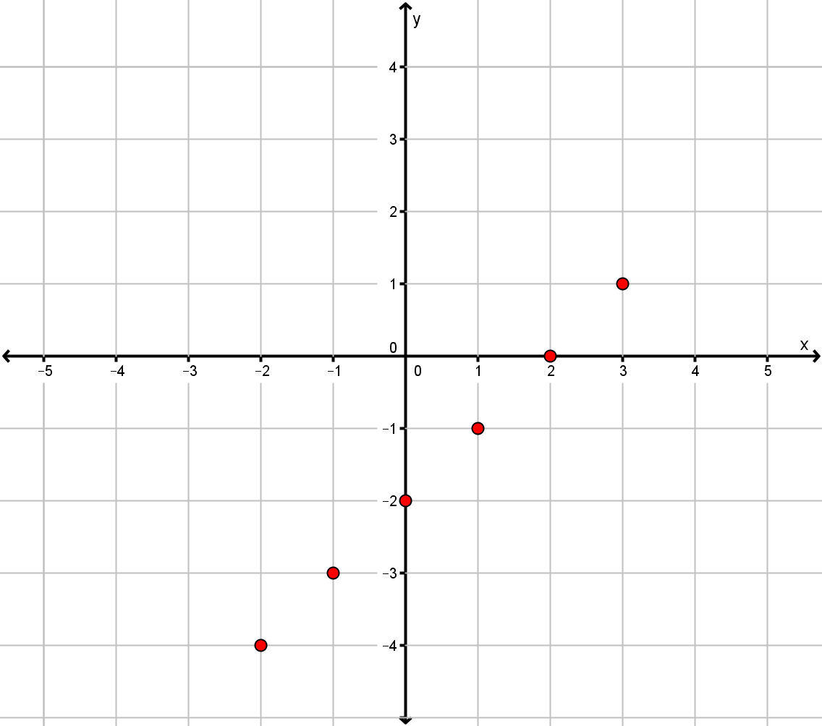

Slide 12
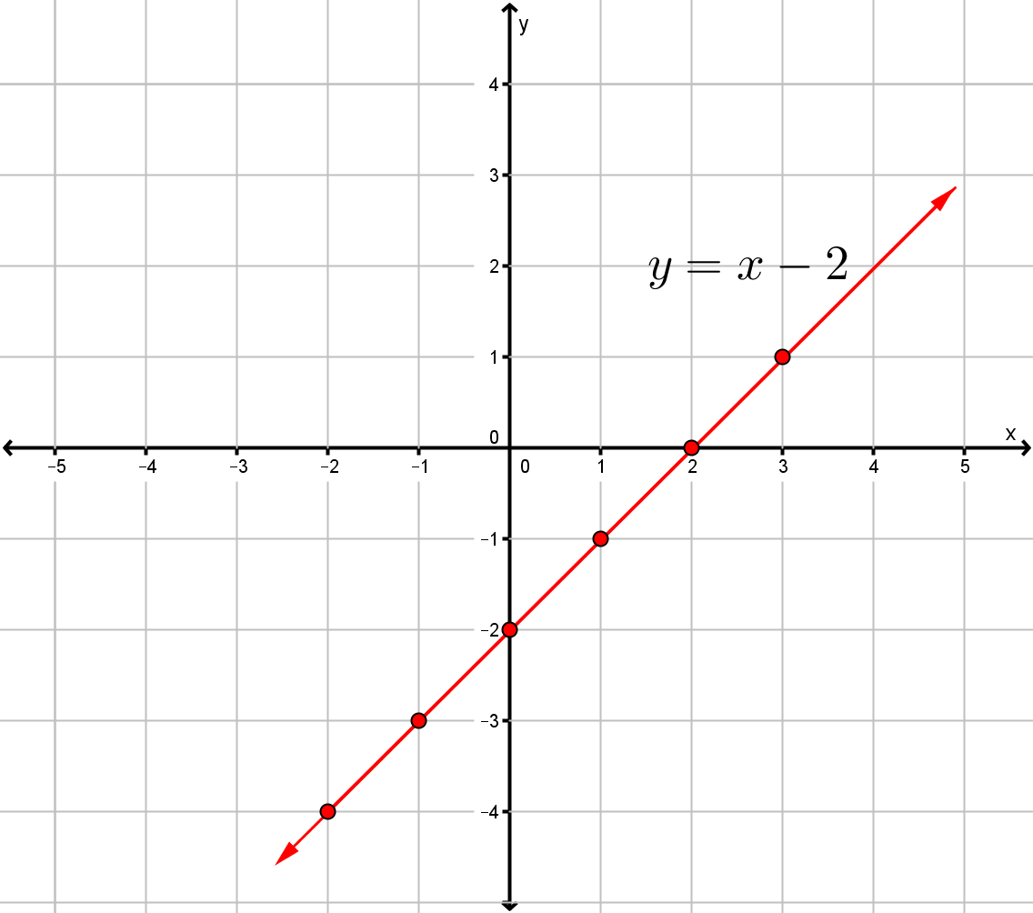

Slide 13

Task – Complete a table and draw the line for the given equation
$y=2x$
$y=x+3$
$y=2x+1$
$y=4−x$
$y=3x−4$
$y=2$

Slide 14
Questions

Slide 15
Notes Review
24, 7 ,30
Date
Title
Essential question
Notes complete
Notes complete with colour and diagrams
Questions completed
Contents page filed in
Formula page filled in

Slide 16
Homework
Review your notes and write a summary answering the essential question.

